Slide 1

Website Watchdog - Uptime Monitoring Using Cloud Services leveraging AI
Team Members: Siddhanth Monappa Kanganda, Mohammed Aiman Khan, Aditya S Raj

Slide 2
Presentation Agenda
01
02
03
Literature Survey
Problem Definition
Proposed Solution
Key findings from 15 research papers.
The challenges of real-time social media analysis.
An overview of our serverless approach.
04
05
Low-Level Design (LLD)
Conclusion & Next Steps
System Architecture, Component Breakdown, Key Data Flows.
Summarizing our findings and future work.

Slide 3
Literature Survey: Key Themes & Insights
Our review of 15 research papers on cloud computing, system architecture, and sentiment analysis revealed three pivotal themes:
Cloud Automation & Compliance
Advanced Sentiment Analysis
Scalable Data Processing
Emphasis on frameworks that automate legal compliance, accessibility, and resource management in the cloud. (Papers 1, 2, 4, 11)
Shift from lexicon-based methods to sophisticated Deep Learning models (LSTM, CNN, Hybrid) for enhanced accuracy. (Papers 6, 9, 13, 14, 15)
Addressing large-scale, real-time social media data streams with serverless and microservice architectures. (Papers 3, 5, 7, 10)

Slide 4

Addressing the Research Gap: Our Unique Approach
Many studies offer advanced sentiment models but lack detailed, scalable, and cost-effective deployment architectures. Our project bridges this gap with an end-to-end server less solution on AWS.
Robust: Built on fully managed AWS services for maximum reliability.
Scalable: Automatically adapts to unpredictable workloads, handling sudden data spikes effortlessly.
Cost-Efficient: Leverages a pay-per-use model, optimizing expenditure by only paying for consumed resources.

Slide 5
The Challenge: Real-Time Social Media Analysis
Analyzing real-time public sentiment from Social Media is crucial for business intelligence, yet it presents significant technical hurdles.
Scalability Demands
Cost Management
Social Media data is massive and prone to sudden spikes (e.g., live events). Traditional server systems struggle to scale cost-effectively.
Provisioning for peak traffic leads to high costs for idle server resources. We need an efficient, pay-as-you-go model.
Real-Time Processing
Operational Overhead
Actionable insights require low-latency ingestion, analysis, and storage.
Managing servers, databases, security, and networking demands significant manual effort.

Slide 6
Real-Time System Challenges
These real-world examples highlight the critical need for robust, scalable systems that can handle sudden surges in demand:
Academic Systems
Ticketing Platforms
VTOP not functioning during crucial times like FFCS registration or assignment upload deadlines.
IRCTC struggling during Tatkal train bookings, causing frustration for users.
Streaming Services
E-commerce Platforms
Buffering or crashes during large-scale sporting events like UEFA Champions League and IPL.
Performance degradation when experiencing high traffic during flash sales or holiday shopping events.

Slide 7
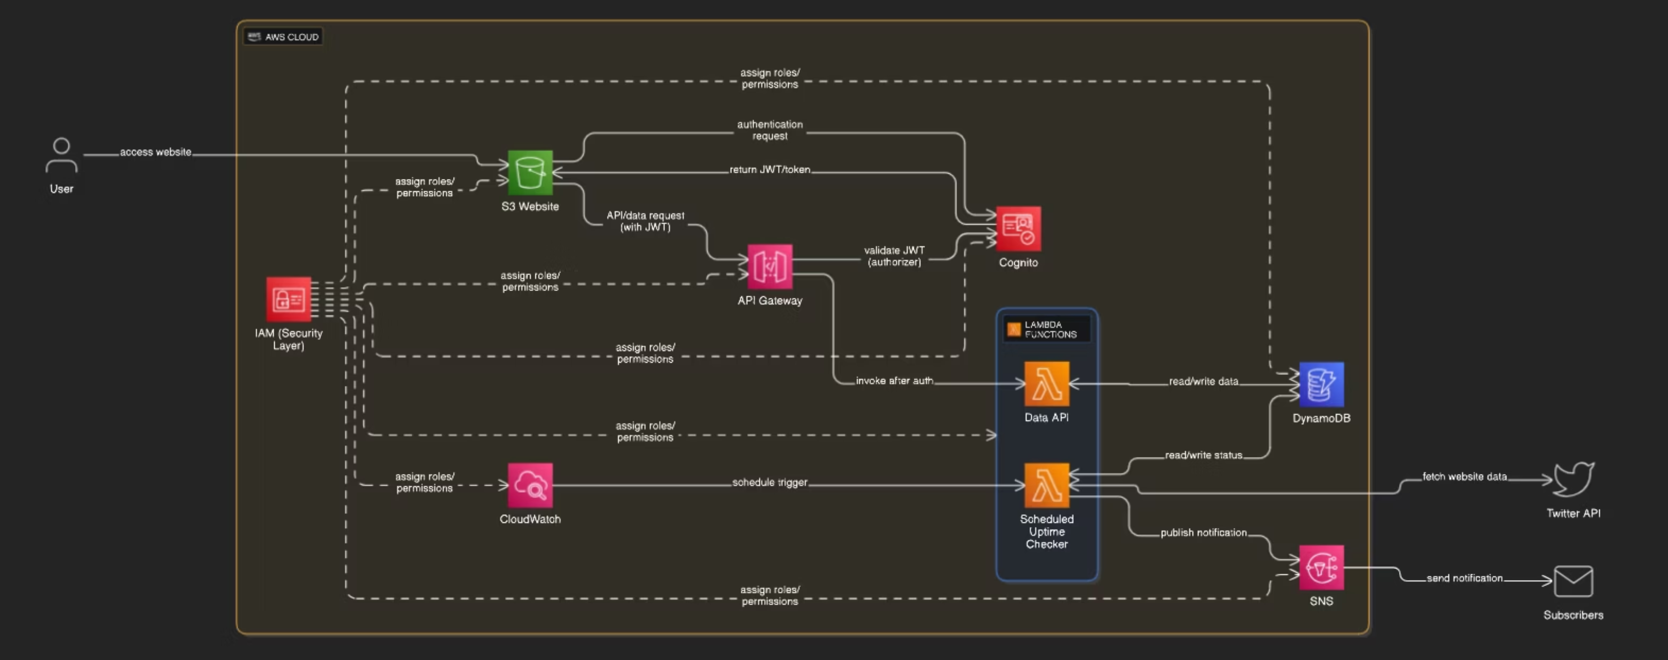
Architecture diagram :

Slide 8

Low-Level Design: System Architecture Overview
Our serverless architecture diagram illustrates two core workflows: the user-facing application and the automated data ingestion pipeline.
This design ensures robust, scalable, and cost-efficient real-time Social Media sentiment analysis.

Slide 9




LLD: Front-end & Security Components
S3 (Static Website)
Cognito (User Authentication)
Hosts the user interface (HTML, CSS, JavaScript) as a globally distributed, low-cost web server.
Manages user sign-up, sign-in, and provides a JWT for API request authorization.
IAM (Security Layer)
The security backbone, enforcing the Principle of Least Privilege via granular permissions to AWS services.

Slide 10

LLD: API & Compute Layer
1
API Gateway
Secure "front door" for backend logic, validating JWTs and routing requests to Lambda functions.
2
Lambda (Serverless Functions)
Executes business logic without server management. Includes Data API Lambda (for user requests) and Scheduled Uptime Checker Lambda (for data fetching and sentiment analysis).

Slide 11


LLD: Data, Monitoring & Notification
These components ensure data persistence, system visibility, and timely alerts.
DynamoDB
CloudWatch
SNS
Fully managed NoSQL database, highly scalable with single-digit millisecond latency for real-time data storage.
Provides scheduled events to trigger Lambdas and aggregates logs for monitoring and debugging across all services.
Managed messaging service for publishing status notifications (e.g., data fetch success/failure) to administrators.

Slide 12




LLD - Data Flow 1: User Reading Data
User Authentication
Request to API Gateway
User logs in via the S3 Website; Cognito authenticates and returns a JWT.
The website sends a request to API Gateway with the JWT.
API Gateway Validation & Trigger
Data Query
API Gateway validates the JWT and triggers the Data API Lambda.
The Lambda function queries the DynamoDB table.

Slide 13
LLD - Data Flow 2: Automated Data Ingestion
CloudWatch Trigger
Fetch Tweets
A CloudWatch scheduled event triggers the Scheduled Uptime Checker Lambda.
The Lambda function makes a call to the external Social Media API to fetch new results.
Process Sentiment
Store Data
The function processes the results to determine their sentiment score.
The processed results and their sentiment scores are stored in DynamoDB.

Slide 14




Key Benefits of Our Serverless Design
Our architecture effectively addresses the challenges of real-time social media analysis, offering significant advantages:
Highly Scalable
Cost-Effective
Automatically scales with demand, no manual intervention needed.
Pay only for compute time consumed, eliminating idle server costs.
Secure
Low Maintenance
Leverages AWS-managed services for identity (Cognito) and access (IAM).
No server patching or management, freeing developers to focus on logic.

Slide 15
Thank You

